Slide 1
Hospital Management System
By,
Srividya Veggalapu - EBEON0722630563
Katyayani Kommoju - EBEON0722629133
K Asha Nandini - EBEON0722628531
Vedita Santosh Mhatre - EBEON0722627266
Guided by
A. Varadharajan

Slide 2
Hospital Management System
Admin Module
Doctor & Patients
Billing & Reports
Infrastructure & Laboratory
Appointment & Pharmacy

Slide 3
Hospital Management System
ADMIN MODULE
Header Section- Home, Admin, Login, Doctor
Body – About us, Contact through What’s app
Footer Section -- Contact us, About Hospital Details, Payment Methods
Admin Dashboard- User details, Add User Details

Slide 4
ADMIN MODULE
Admin are responsible for Organizing & Overseeing the health services & daily activities of a Hospital and Health Care Facilities.
Admin Dash Board
Line Chart & Pie chart
Patient Success Status and lists
Doctor Lists
Appointments
It is also Interconnected with Doctor, Patient, Inventory, Laboratory, Billing, Reports and many.

Slide 5
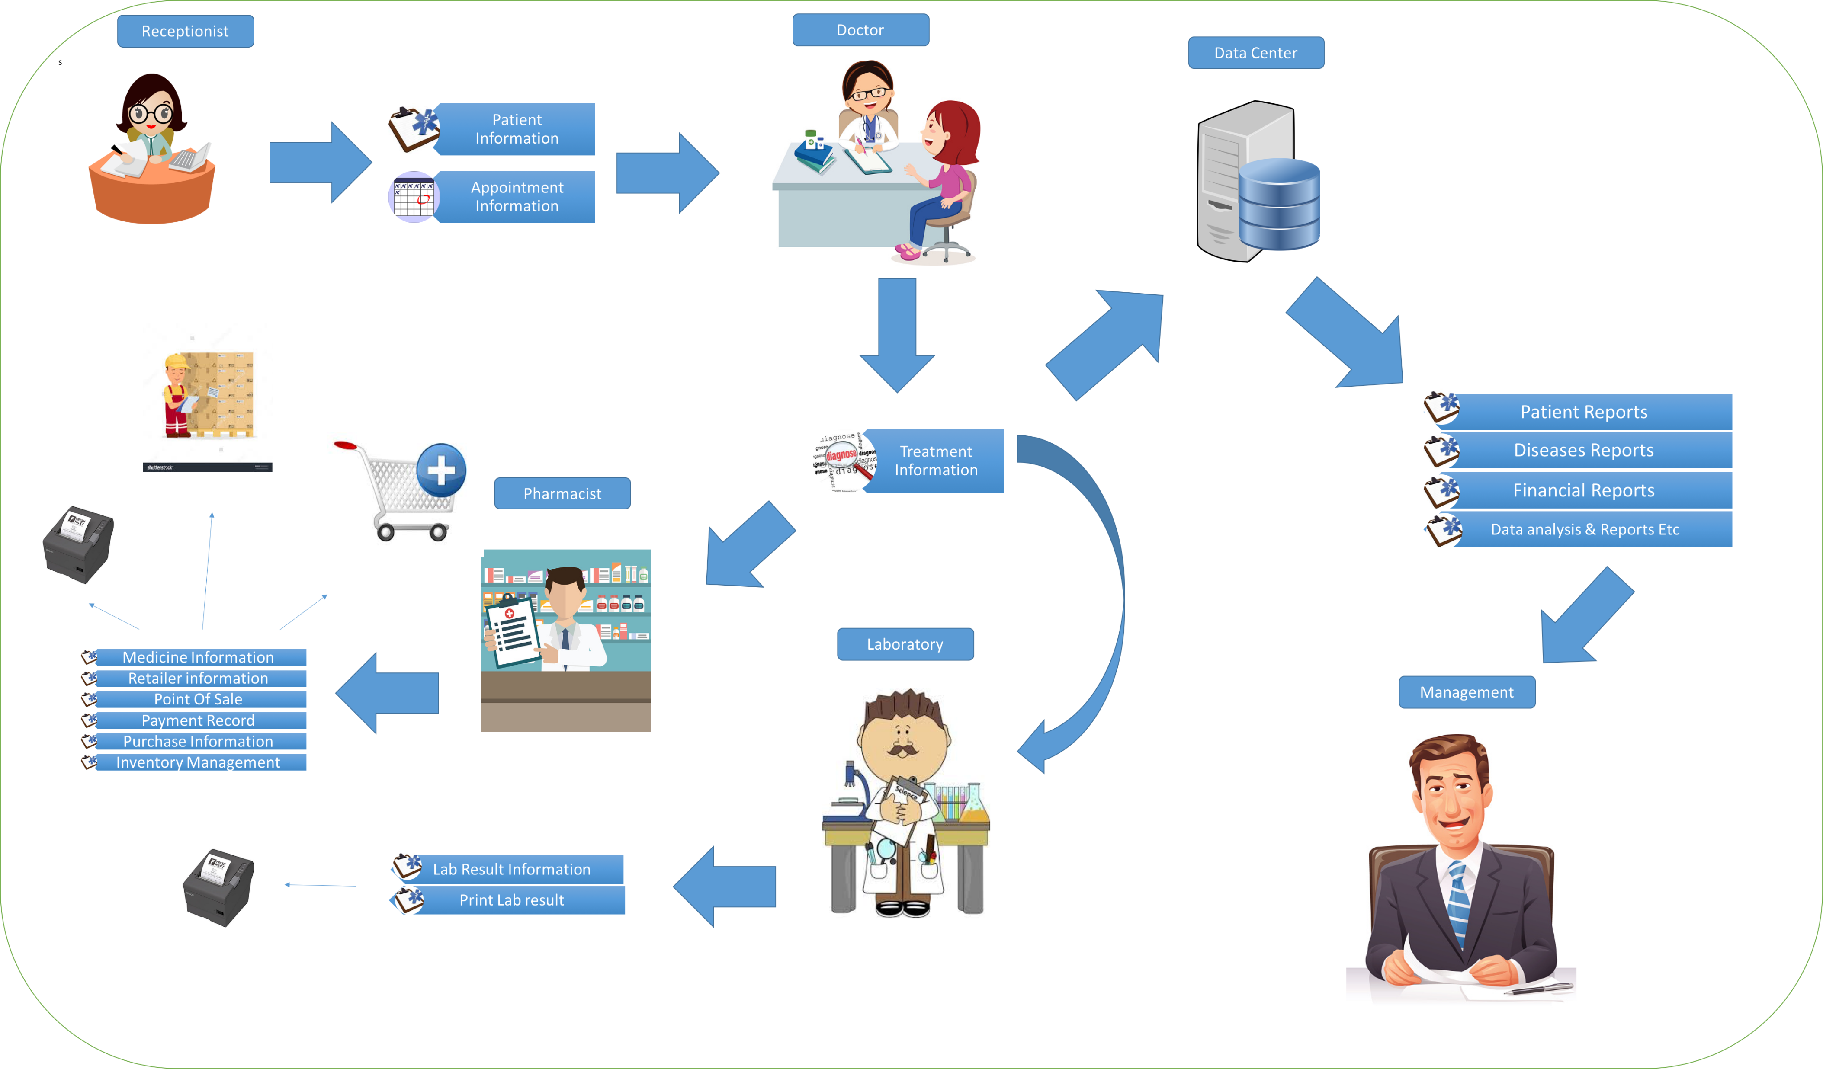
Overview Admin Architecture

Slide 6
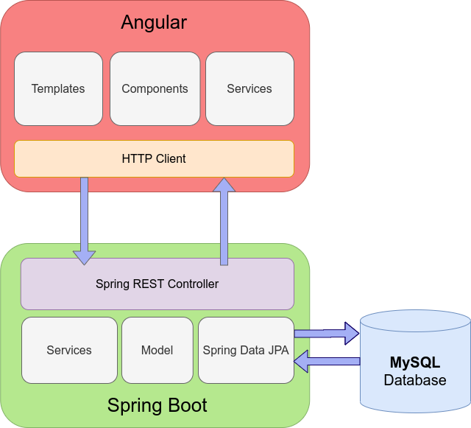
Technical architecture

Slide 7
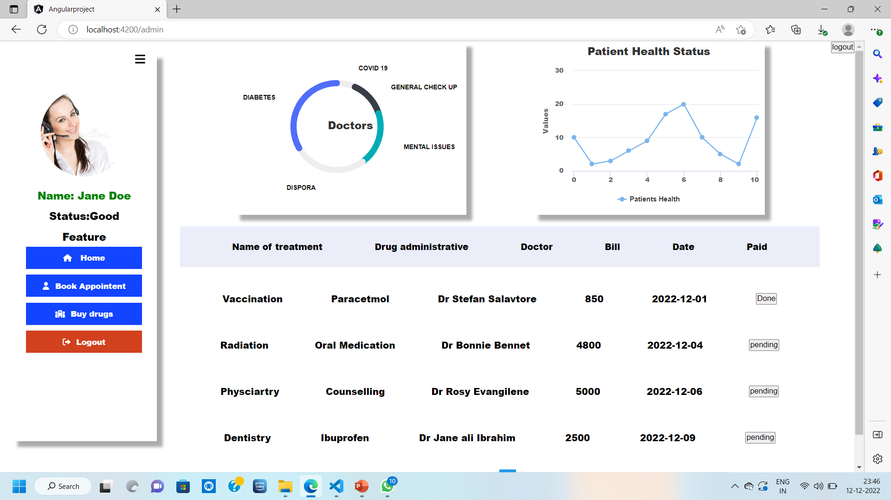
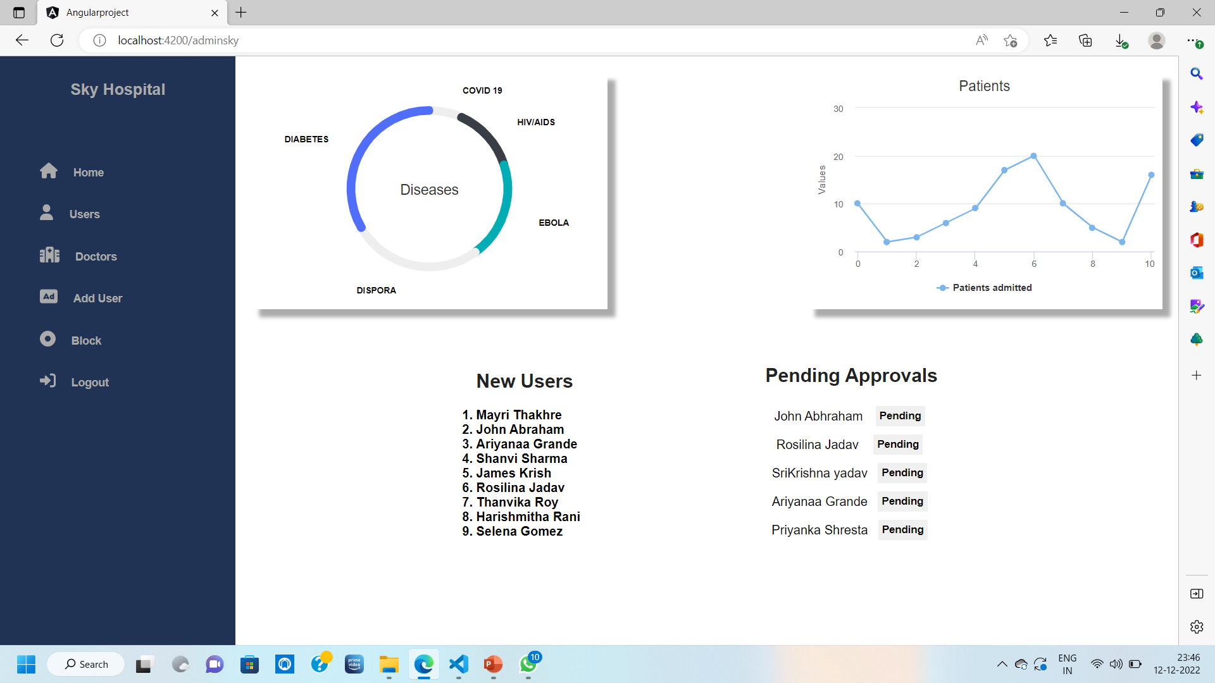
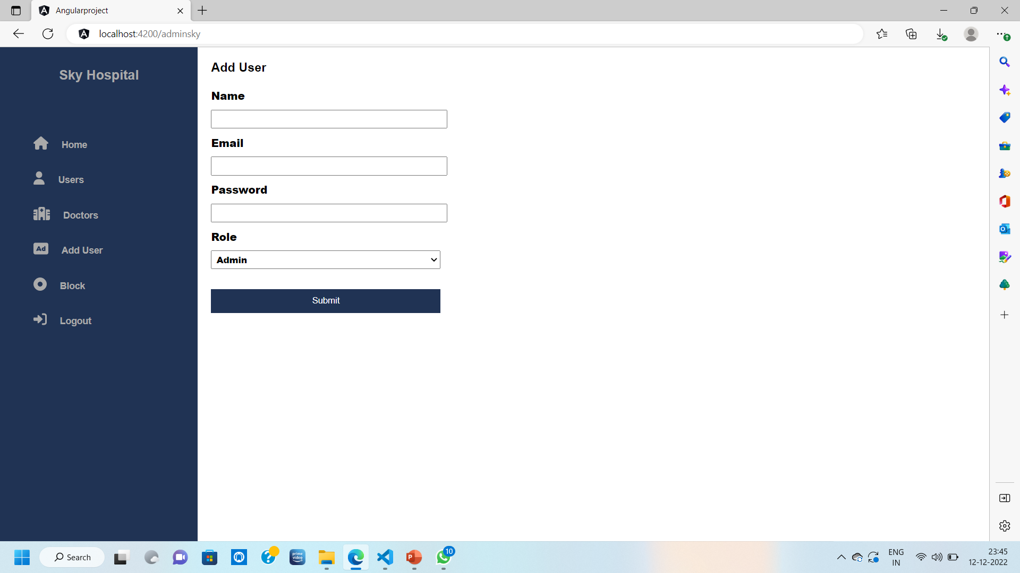
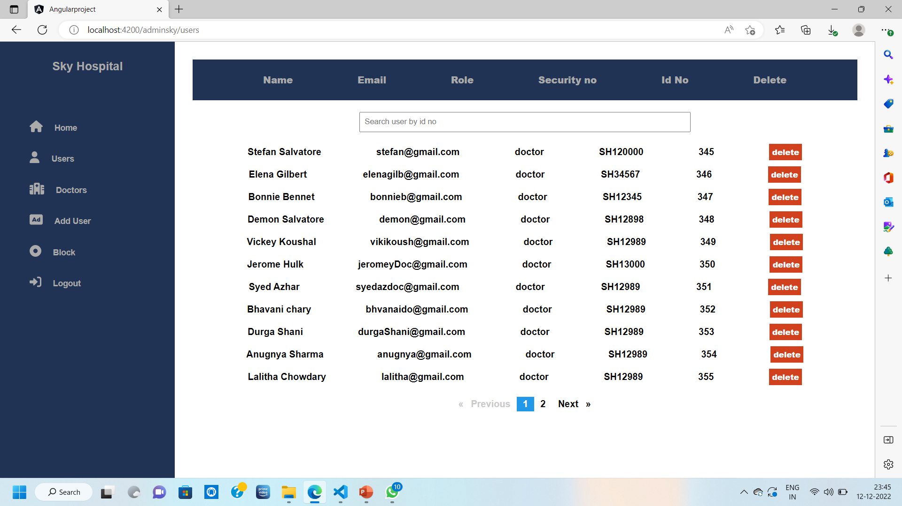

Output HMS

Slide 8
Challenging issues
There is a shortage of professional healthcare faculty with in-depth knowledge of HMS and other similar technologies.
Implementing newer innovations in both hardware and software is required to overcome data entry difficulties.

Slide 9
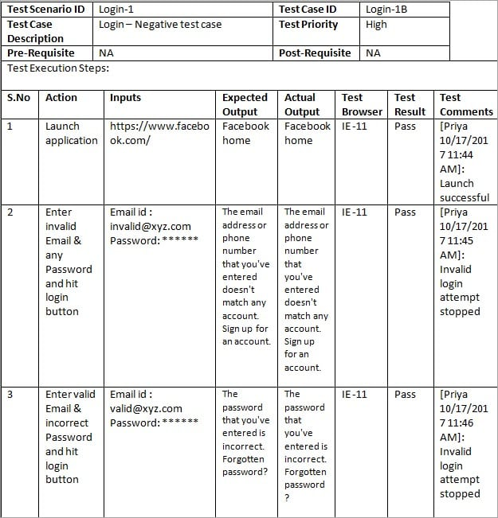
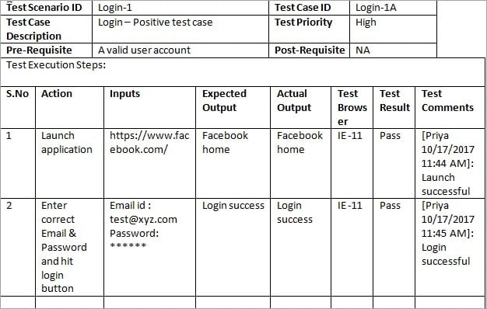
Testing

Slide 10
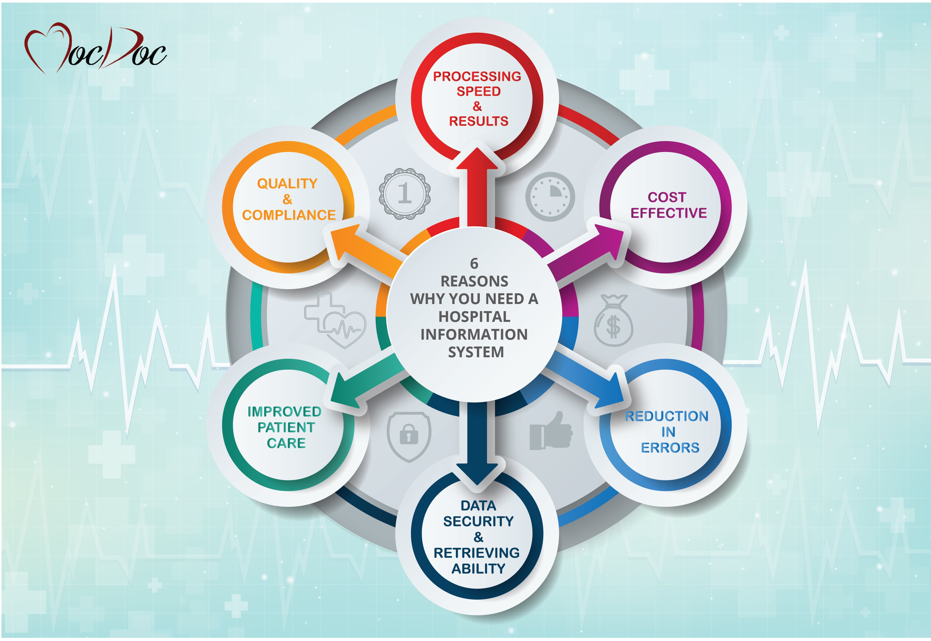
Future enhancement
Automate any processes, including financial auditing, regulatory compliance, scheduling, appointments, and billing with the MocDoc hospital management system. Enhance your healthcare services quality with our custom hospital information system software.
MocDoc is a leading-edge, informative, and cost-effective hospital information system software that offers focused, actionable, and insightful data. We provide an all-in-one solution that can be customized and deployed for any healthcare institution or hospital, providing the right state-of-the-art services to the patients. MocDoc HMS enables seamless integration with any of your systems like LIS, PACS, EMR, RIS, CDSS, and more.

Slide 11
Conclusion
In conclusion, Implementation of hospital management system project helps to store all the kinds of records, provide coordination and user communication, implement policies, improve day-to-day operations, arrange the supply chain, manage financial and human resources, and market hospital services.

Slide 12

Acknowledgement:-
I am thankful to varadharajan For being so supportive and encouraging to complete this Project to end
Thank you Sir.

